Slide 1
Basic Details of the Team and Problem Statement
for development of
Problem statement: Rain water harvesting
Team Name: Ritika
Team Leader Name: Ritika Bhagwat
No. of Team members: 01

Slide 2
Idea/Approach Details
Catchment Area: The project will utilize the rooftops of the residential buildings as the primary
catchment area for rainwater. The rooftops will be equipped with gutters and downspouts to direct
rainwater into the collection system.
Storage Tanks: Underground storage tanks will be installed to store harvested rainwater. The tanks will have
a capacity based on the average annual rainfall and the water needs of the complex.
Filtration and Treatment: Before entering the storage tanks, rainwater will undergo a series of filtration
processes to remove debris, leaves, and other contaminants. An initial mesh filter will capture larger
particles, followed by a sand and gravel filtration system to remove finer sediments.
Distribution System: A network of pipes and pumps will distribute the harvested rainwater to various points
of use within the complex. These points may include irrigation for landscaped areas, toilet flushing, and
vehicle washing.
Monitoring and Control: The system will incorporate sensors and control mechanisms to monitor water
levels in the storage tanks and control the distribution
Solar-Powered Pumping and Filtration: Utilizing solar energy to power pumps and filtration systems, reducing the
environmental impact and energy costs associated with rainwater harvesting operations.

Slide 3
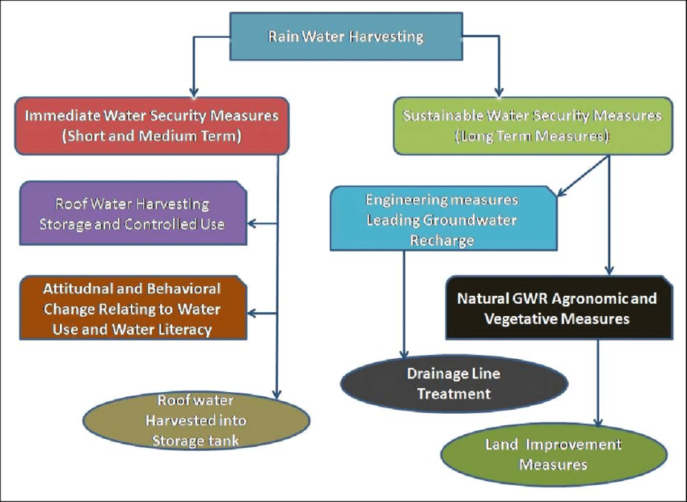
FLOW CHART

Slide 4
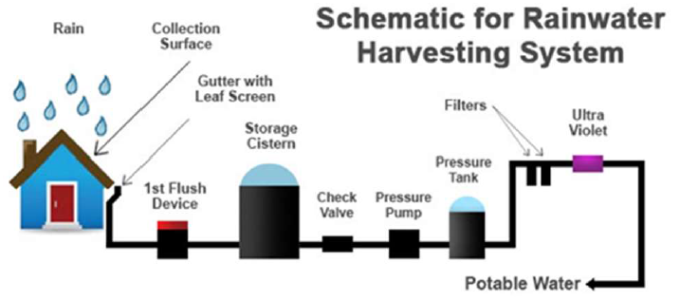
Technology stack

Slide 5
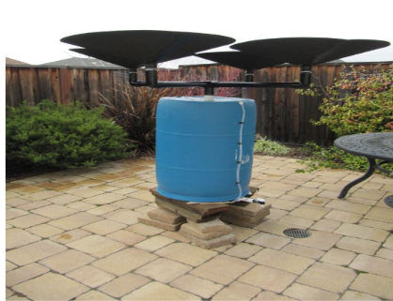
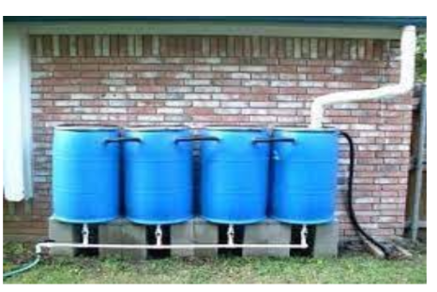
USE CASES :
Conservation: Rainwater harvesting and management help conserve water by capturing and
utilizing rainwater for various purposes such as irrigation, landscaping, flushing toilets, and even
for potable uses with proper treatment. This reduces the demand on local water supplies.
Technological Innovation: The concept of turning rain into a resource has led to technological
advancements in rainwater harvesting systems, storage solutions, and water treatment methods.
These innovations contribute to more efficient water utilization.
Sustainability:
Effective rainwater harvesting contributes to water resource sustainability and resilience to
climate change.

Slide 6
The rainwater harvested depends upon the catchment area, the rainfall pattern in the area and the drainage/ collection system used. To understand the potential for rainwater harvesting, lets take the example of a house in Delhi with a terrace area of 100 sqm. Taking the average annual rainfall in Delhi as 600 mm, and assuming 70% harvesting efficiency (as some rainwater will be lost due to evaporation, collection etc.), we can calculate the amount of water harvested thus: : Volume of water harvested = 100 x 0.6 x 0.7 = 42,00The rainwater harvested depends upon the catchment area, the rainfall pattern in the area and the drainage/ collection system used. To understand the potential for rainwater harvesting, lets take the example of a house in Delhi with a terrace area of 100 sqm. Taking the average annual rainfall in Delhi as 600 mm, and assuming 70% harvesting efficiency (as some rainwater will be lost due to evaporation0 litres This volume is more than twice the annual drinking water requirement of a 5-member family, whose average daily drinking water requirement is 10 lpcd. he cost will vary depending upon the catchment area and the conveyance/ storage structures finalised. RWH can be installed at a very low cost in large plots where public buildings, schools & colleges are located, and this cost is negligible to the total construction cost, if integrated with the building design. If planned in an existing building, the cost is higher due to extra plumbing involved, but the returns are rich in terms of recurring benefits.
Dependencies

